Slide 1
UKF Tractography Tutorial
Pegah Kahali, M.D.
Surgical Planning Laboratory
Harvard Medical School

Slide 2
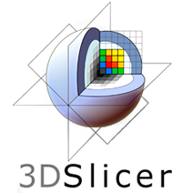
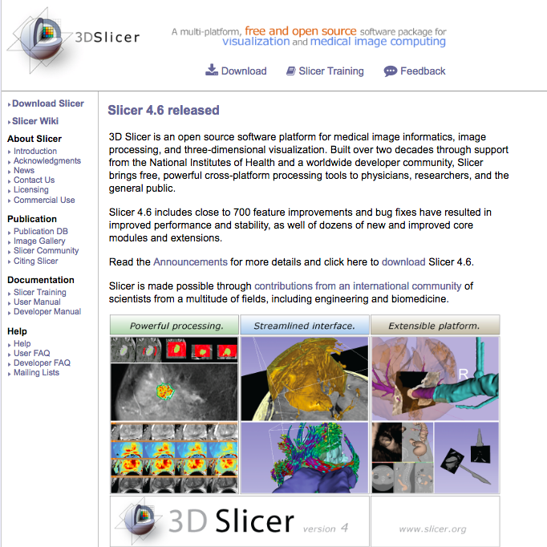
3DSlicer
The tutorial uses the 3DSlicer software (www.slicer.org)
It is the responsibility of the user of 3DSlicer to comply with both the terms of the license and with the applicable laws, regulations and rules. Slicer is a tool for research, and is not FDA approved.

Slide 3
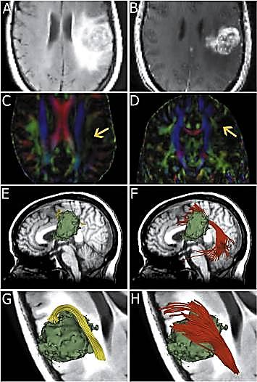
3DSlicer
An end-user application for image analysis
An open-source environment for software development
A software platform that is both easy to use for clinical researchers and easy to extend for programmers
[Chen et al, 2015]
3D Slicer is a multi-institution effort supported by the National Institutes of Health.

Slide 4
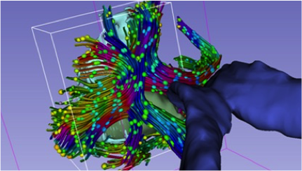
Slicer DMRI
An open-source project to improve and extend diffusion magnetic resonance imaging software in 3D Slicer:
http://slicerdmri.github.io Please read the Diffusion MRI Analysis tutorial to install SlicerDMRI:
https://github.com/SlicerDMRI/slicerdmri.github.io/blob/master/docs/tutorials/DiffusionMRIanalysis.pdf
3D Slicer is a multi-institution effort supported by the National Institutes of Health.

Slide 5
UKF Installation
3D Slicer now supports plug-ins/extensions that are available for download from an extension server. Extensions allow end-users to selectively install features that are useful for them.
UKF tractography can be installed on Slicer using “Extension Manager”.
Instructions for Extension Manager: http://www.slicer.org/wiki/Documentation/4.6/SlicerApplication/ExtensionsManager

Slide 6
UKF Tractography
Unscented Kalman Filter tractography method:
Simultaneous model estimation and tractography
The diffusion model is fit to the data during tractography not before.

Slide 7
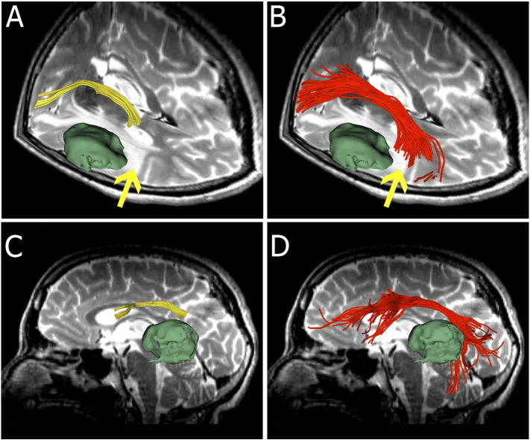
Why UKF
UKF tractography may detect more fibers comparing to single-tensor streamline tractography (Slicer default method), especially in edematous areas.
For example: The UKF two-tensor model traces a larger volume arcuate fasciculus in the setting of edema.
[Chen et al, 2015]

Slide 8
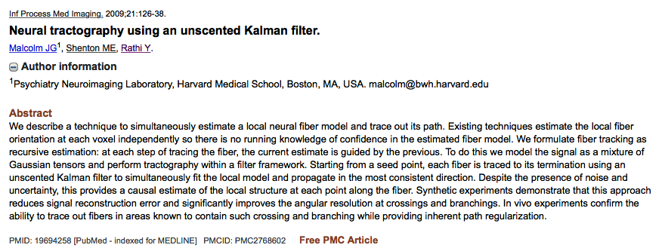
Unscented Kalman Filter Tractography
Neural Tractography Using an Unscented Kalman Filter
[Malcom et al., 2009]

Slide 9

Before getting started…
take a look at: Diffusion Tensor Imaging Tutorial https://github.com/SlicerDMRI/slicerdmri.github.io/blob/master/docs/tutorials/DiffusionMRIanalysis.pdf

Slide 10
DWI Dataset
Download the data at: https://www.slicer.org/w/images/e/e6/Dti_tutorial_data.zip
The Diffusion Weighted Imaging (DWI) dataset is composed of :
1 volume acquired without diffusion-sensitizing gradient
41 volumes acquired with 41 different diffusion-sensitizing gradient directions

Slide 11
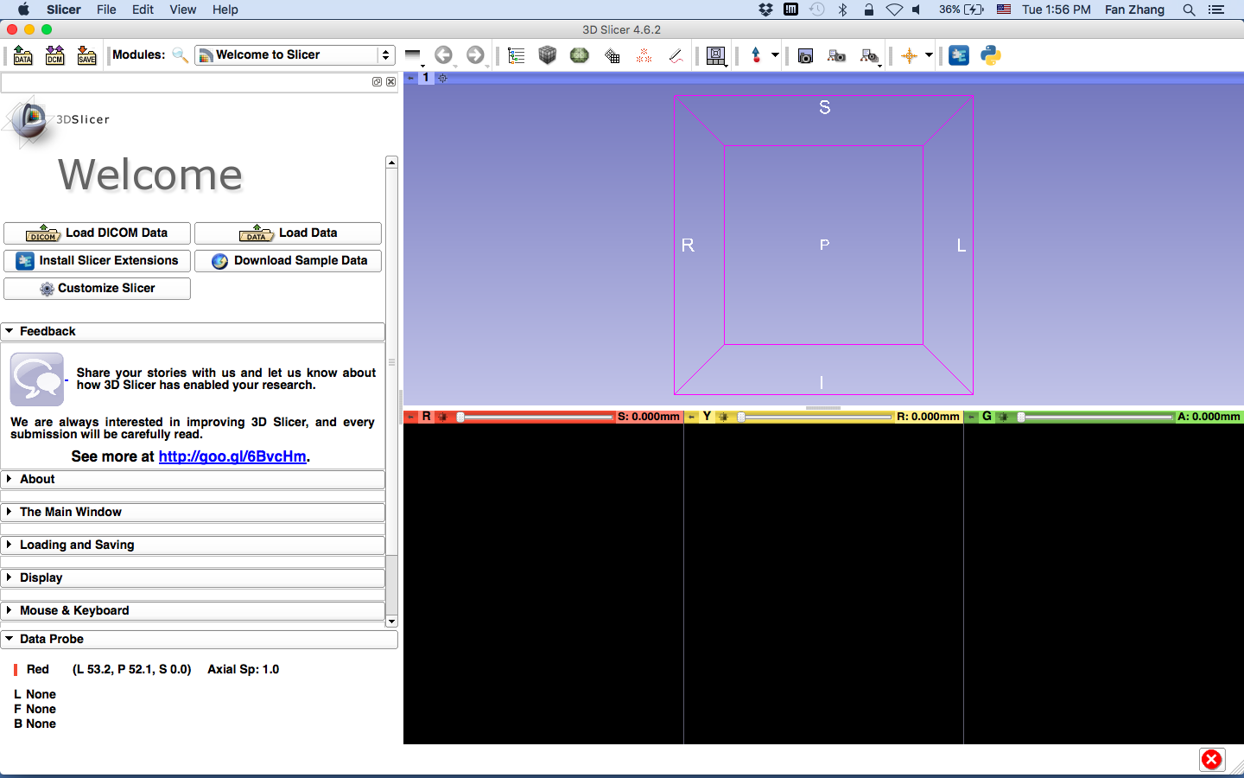
Start Slicer

Slide 12
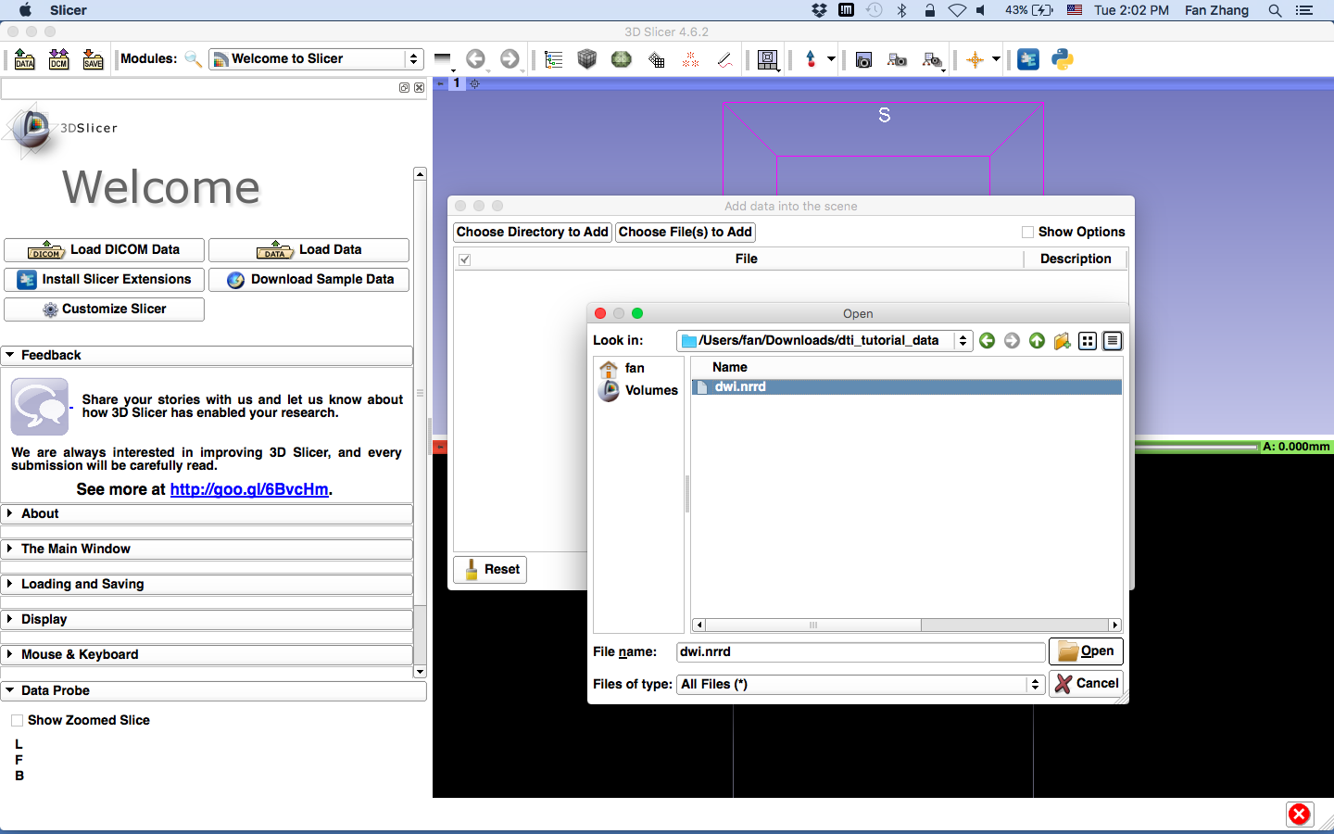
Load the data
1
2
3

Slide 13
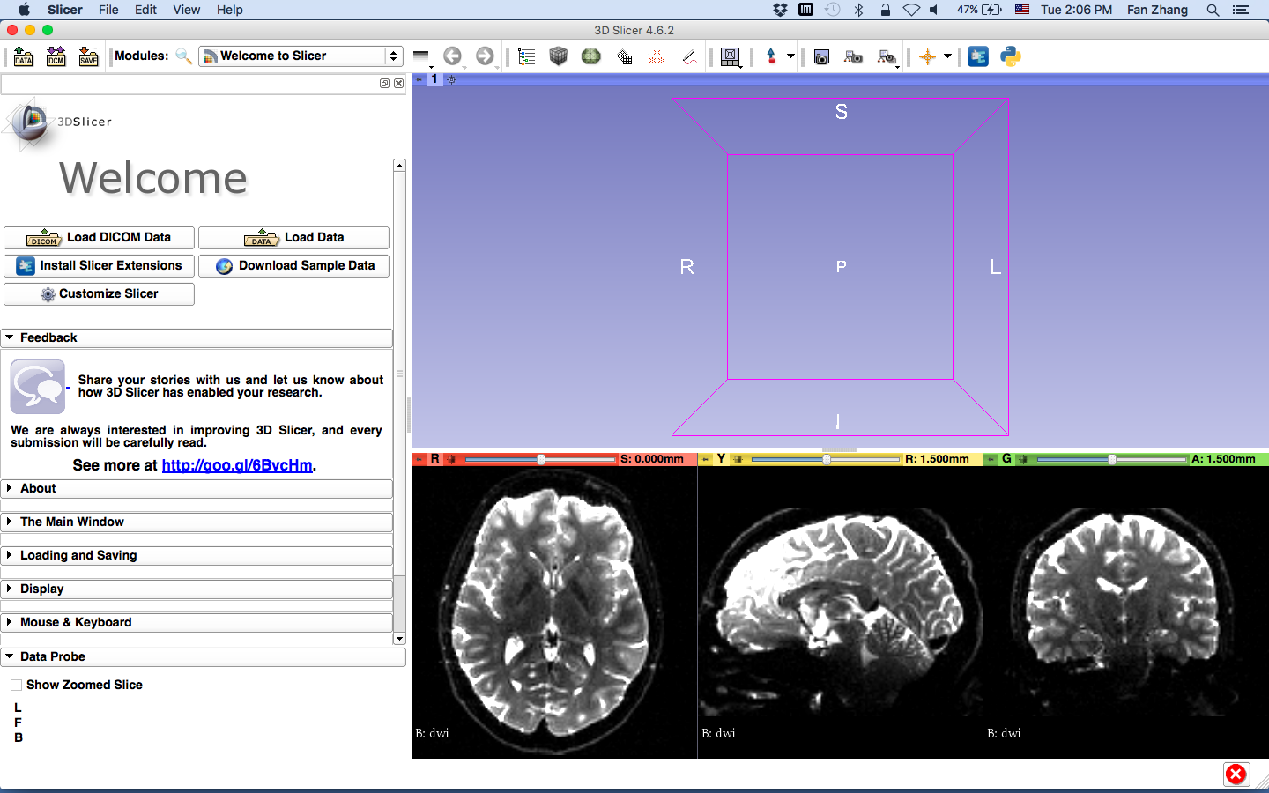
There you go…!

Slide 14
Main Steps
Creating a brain mask
Creating FA map
Creating region of interest for tract seeding
UKF tractography

Slide 15
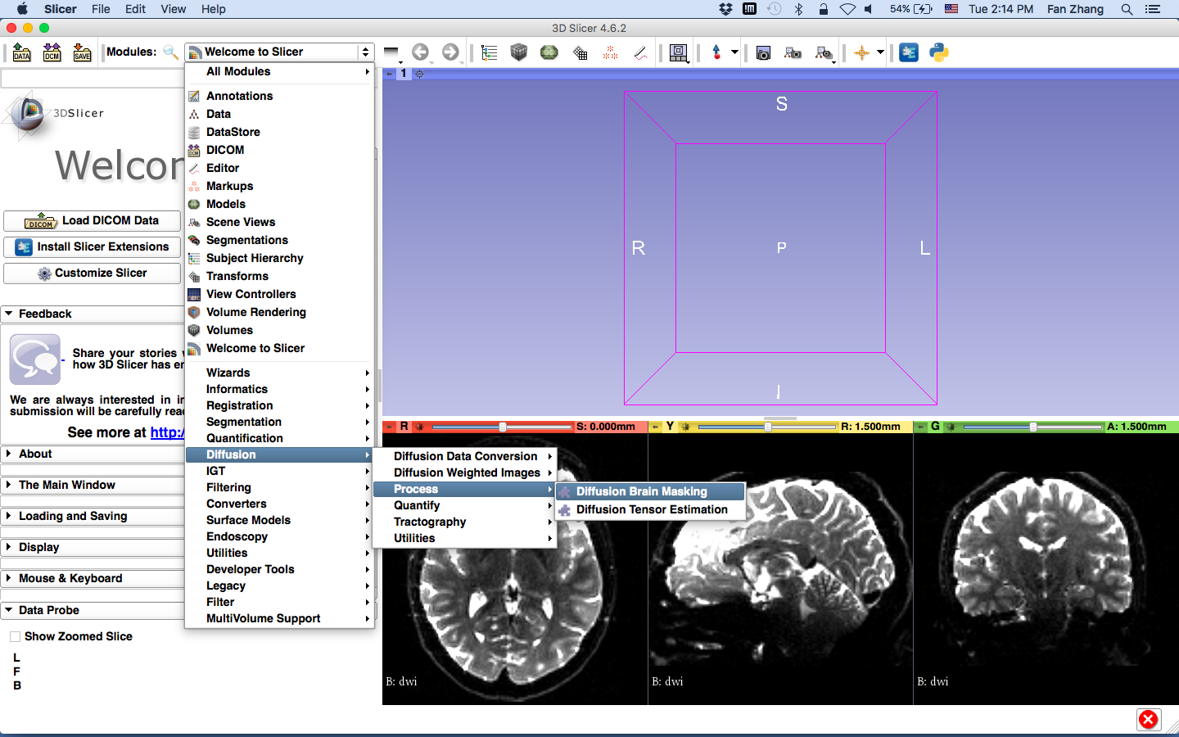
Brain Mask Creation
select “Diffusion Brain Masking”

Slide 16
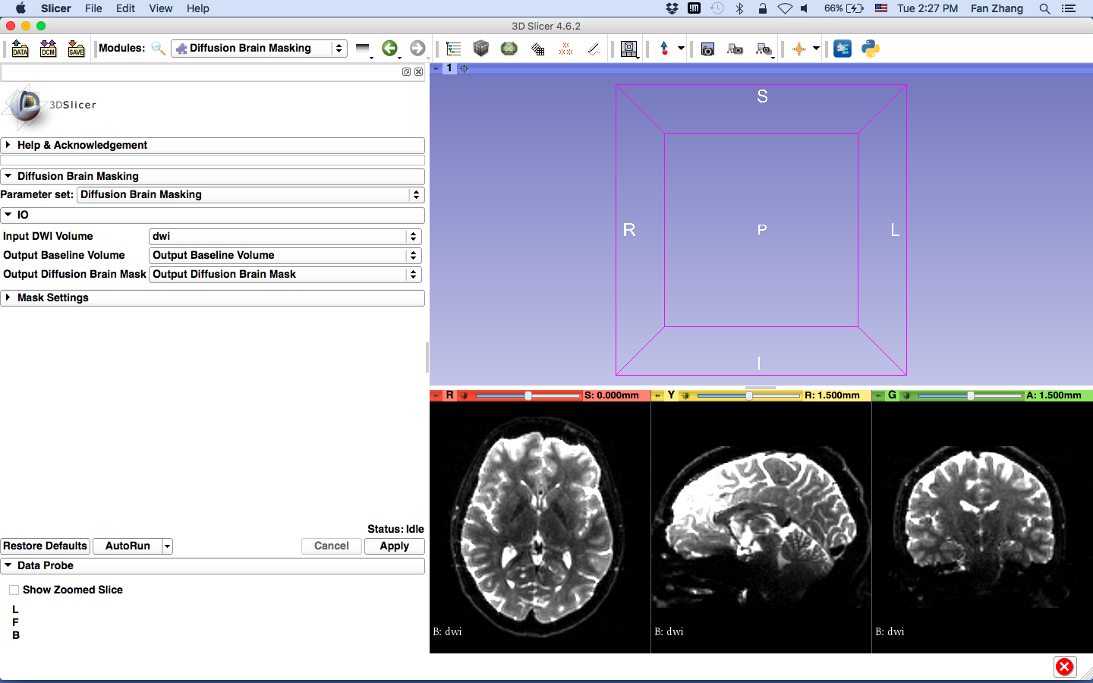
the input is the DWI volume you loaded
create new volumes as the Baseline and Mask

Slide 17
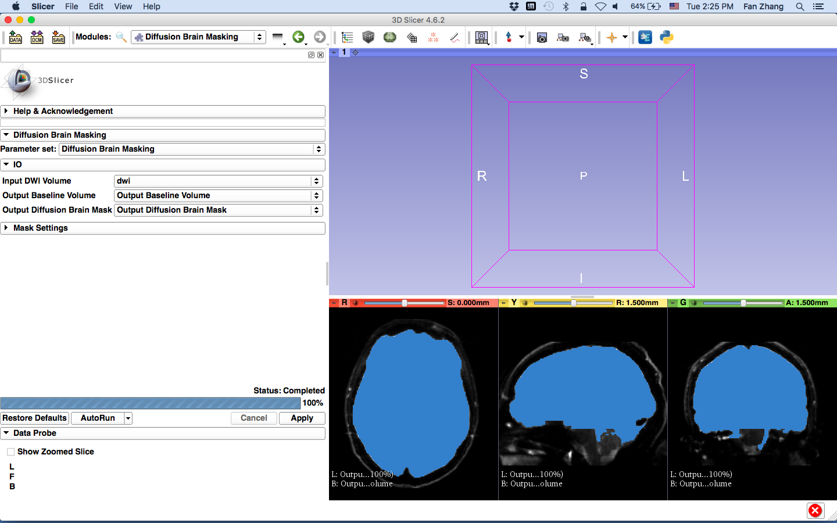
this mask can then be used when estimating the diffusion tensor image, in order not to estimate tensors all over the volume

Slide 18
Tract Seeding
For whole brain tractography with UKF, the Otsu threshold mask is used as the brain mask.
To seed a specific tract of interest, label maps can be drawn on either:
DWI (output baseline volume)
FA map

Slide 19
Tract Selection
Note that FA maps can be more informative for selecting ROIs.
For that purpose you should first estimate DTI and calculate FA map
Although these maps are only used here for ROI selection and the model is again estimated from DWI for UKF tractography.

Slide 20
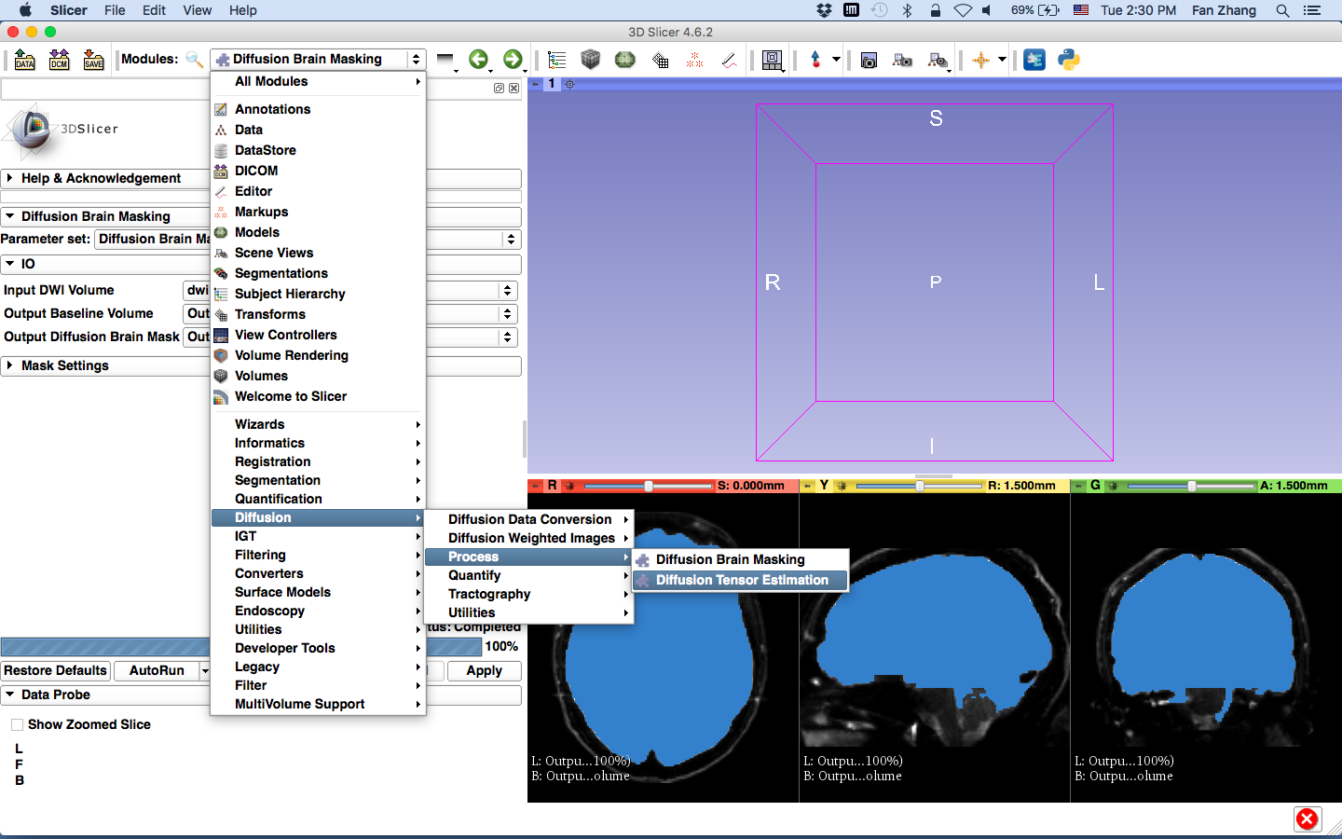
DWI to DTI Estimation
select this module

Slide 21
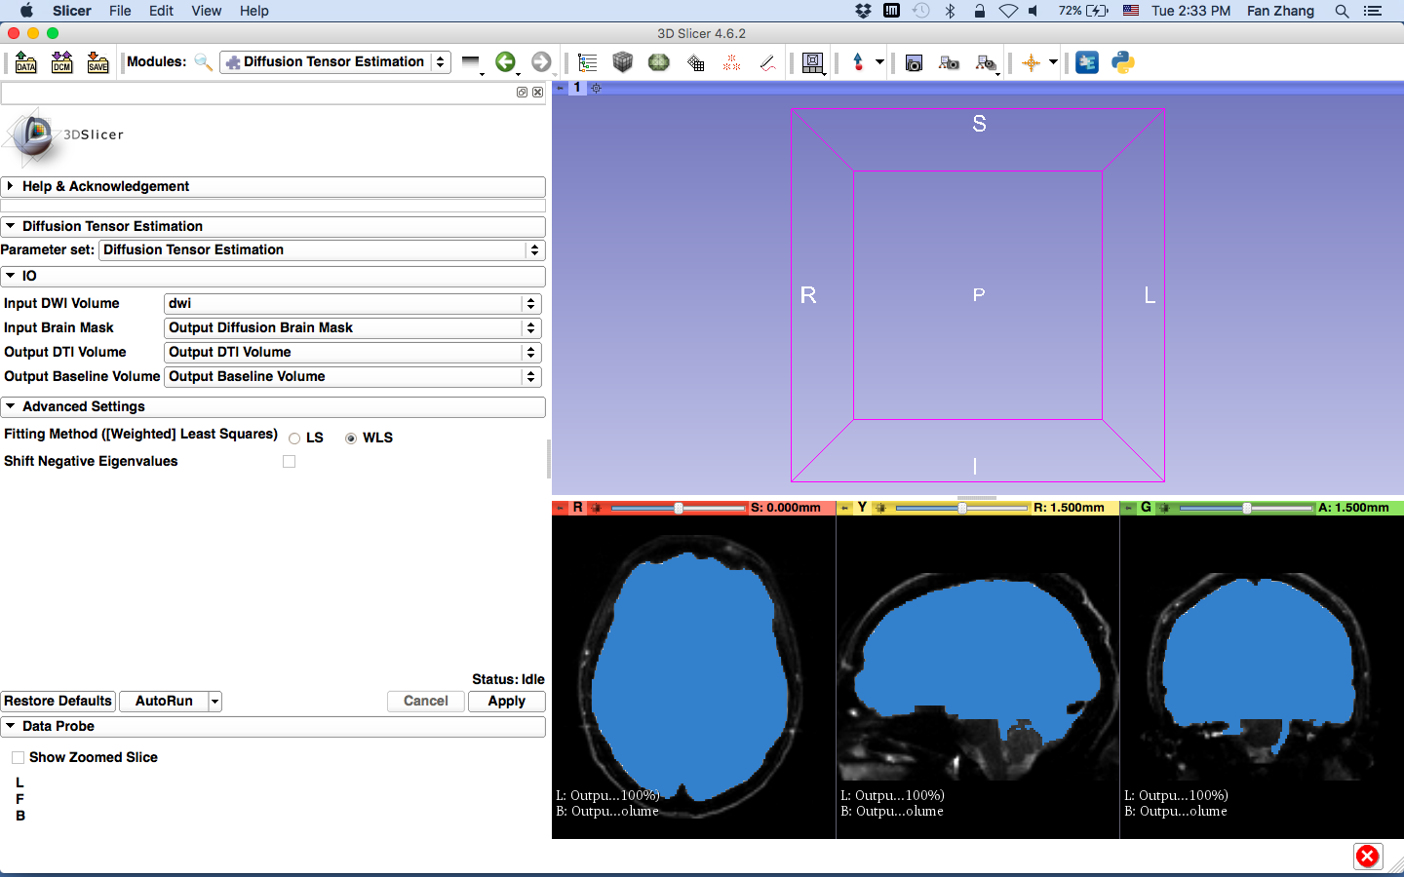
Set the Parameters

Slide 22
select Output Diffusion Brain Mask you already created
create new Output DTI Volume
select the “Output Baseline Volume” you already created
select WLS (Weighted Least Square)
Click Apply

Slide 23
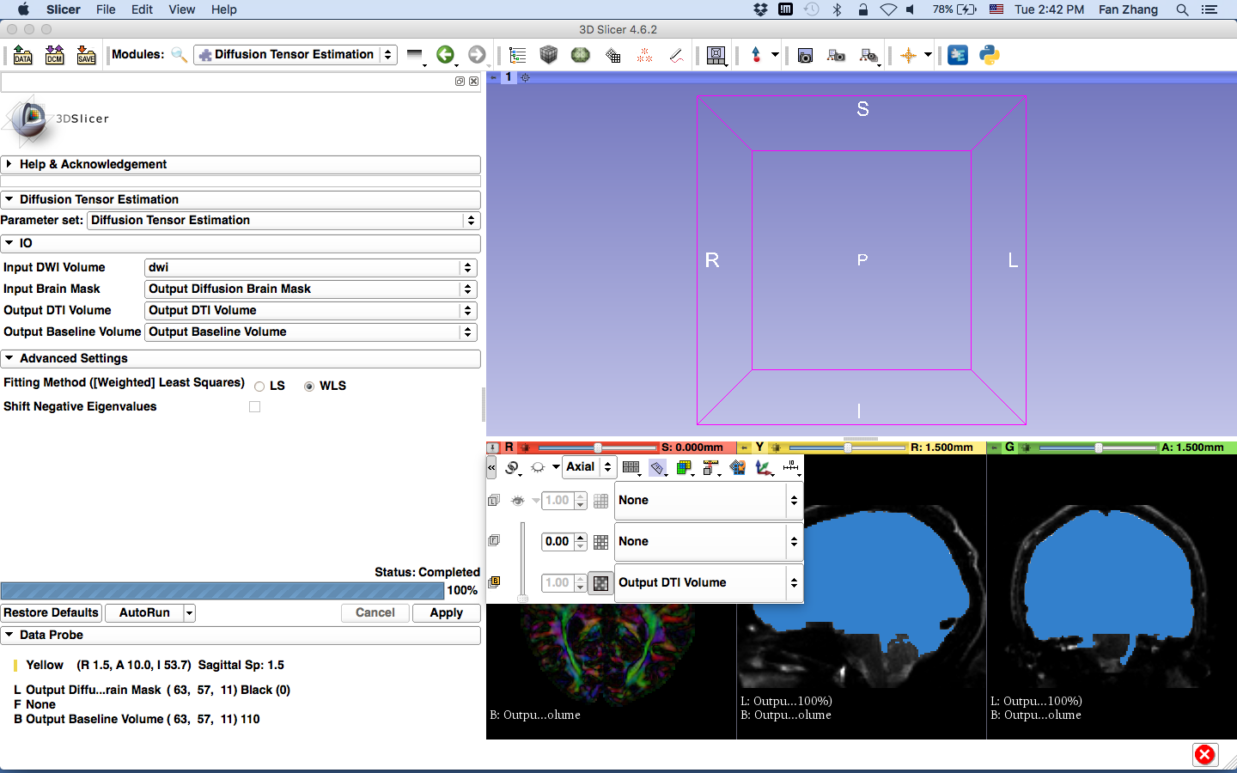
Status: Completed! 100%
select “Output DTI Volume” as the background and “None” for foreground and label map

Slide 24
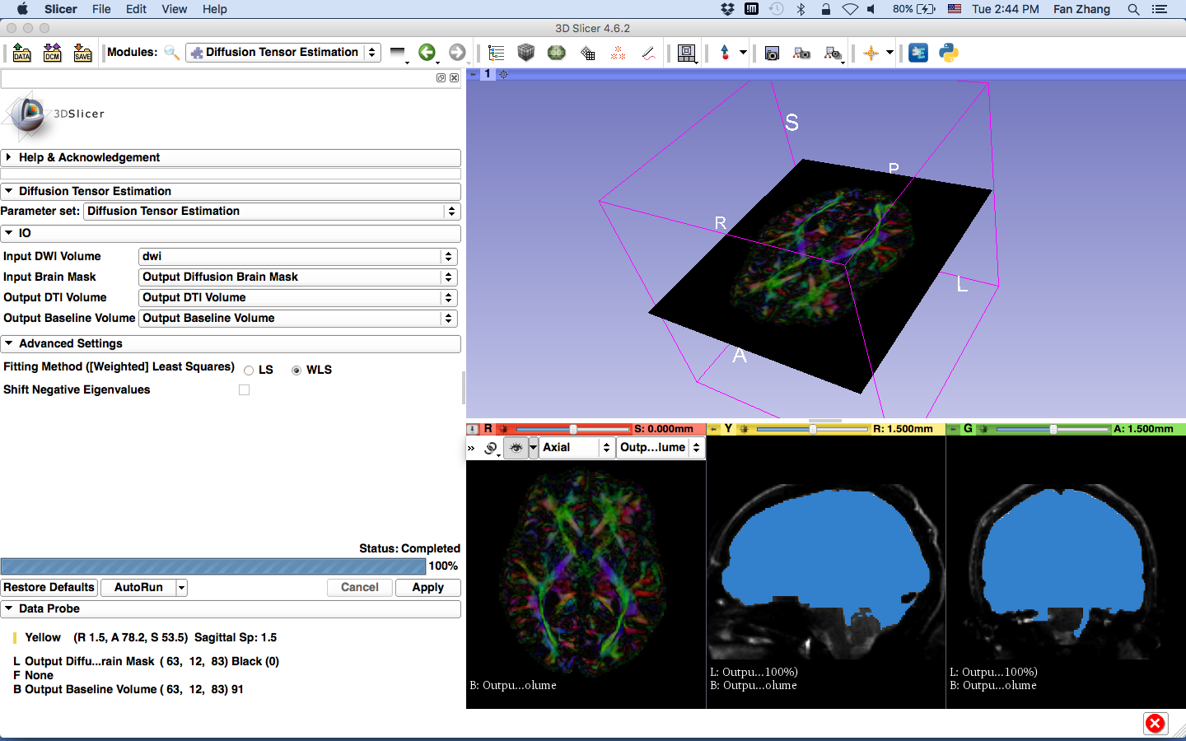
color-coded DTI volume
if you click on the “eye” icon, you’ll have the slice in the 3D viewer

Slide 25
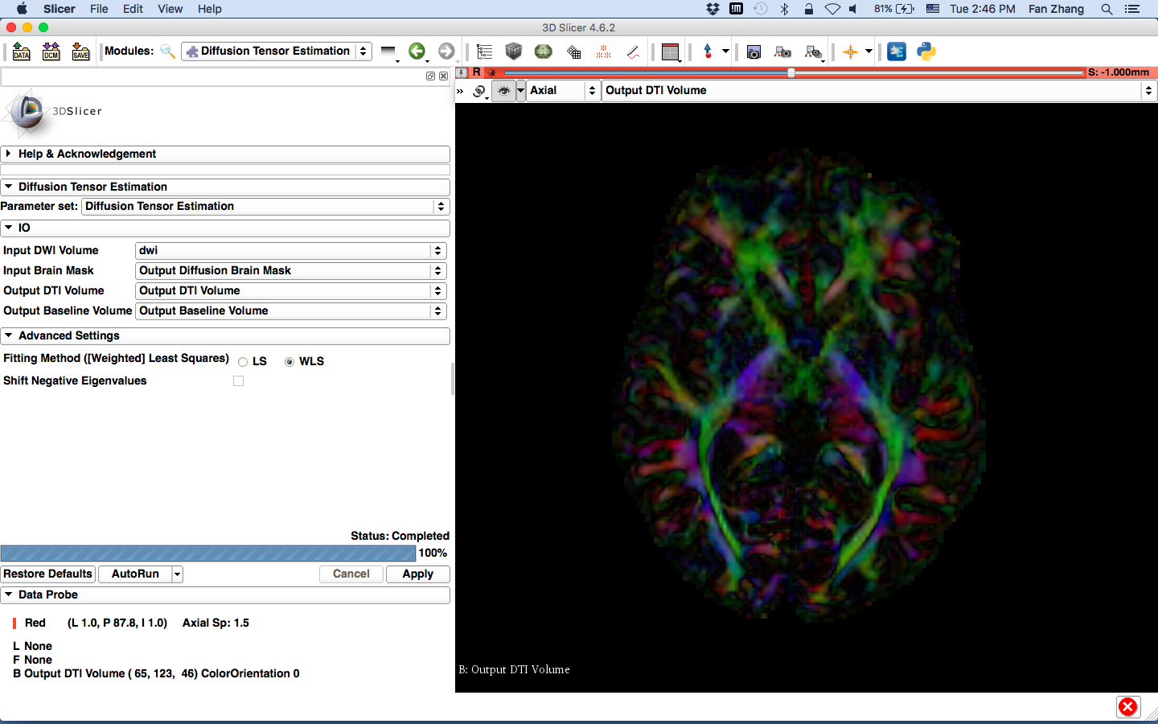
browse through the DTI volume here

Slide 26
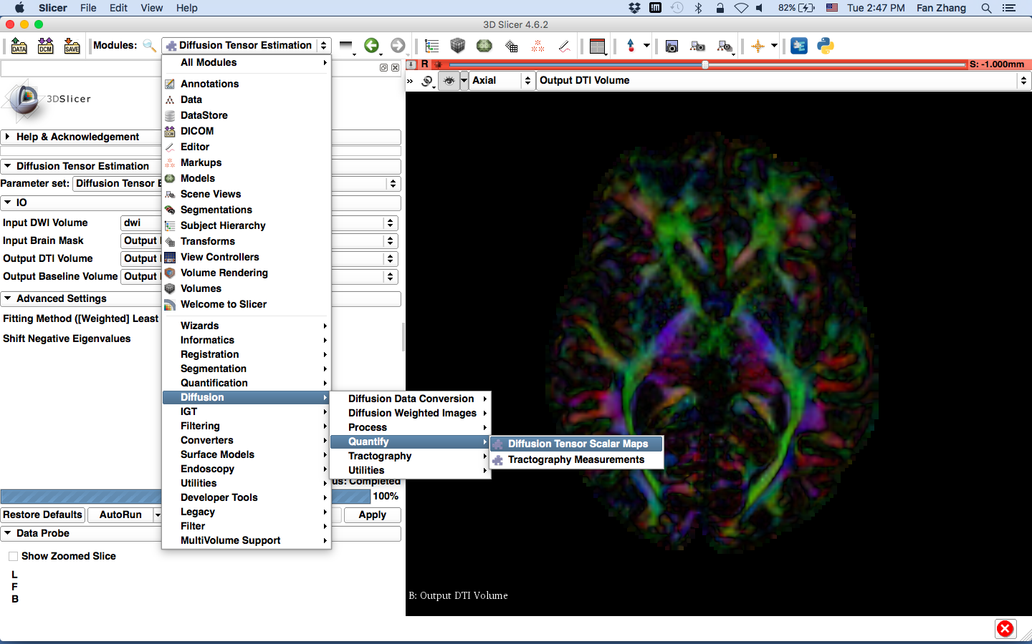
Diffusion Tensor Scalar Measurements; FA
select the module

Slide 27
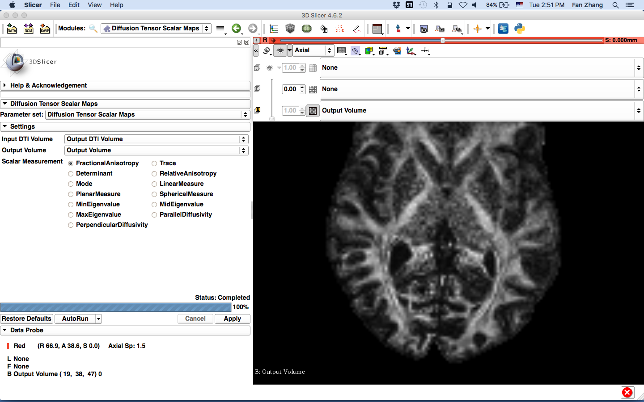
create new Output Volume (FA)

Slide 28
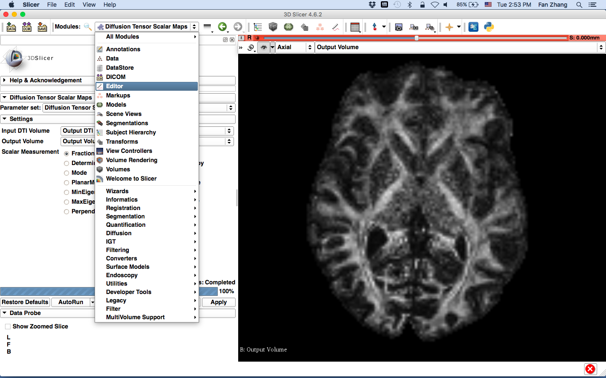
Select the Editor Module

Slide 29
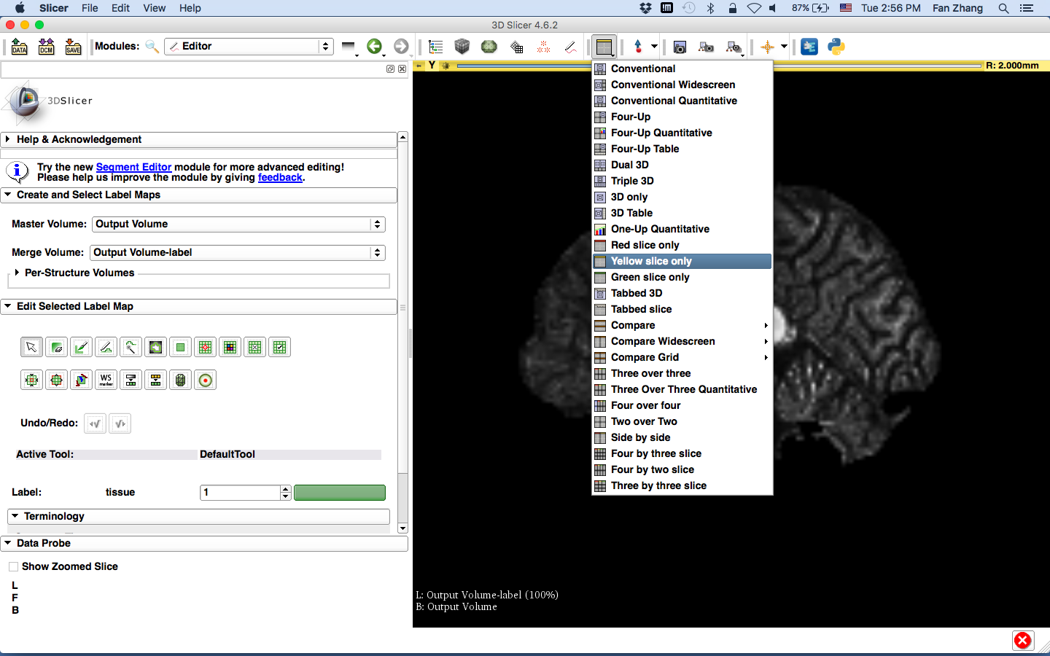
to be able to select ROI for CC as an example, select sagittal view (yellow slice only)

Slide 30
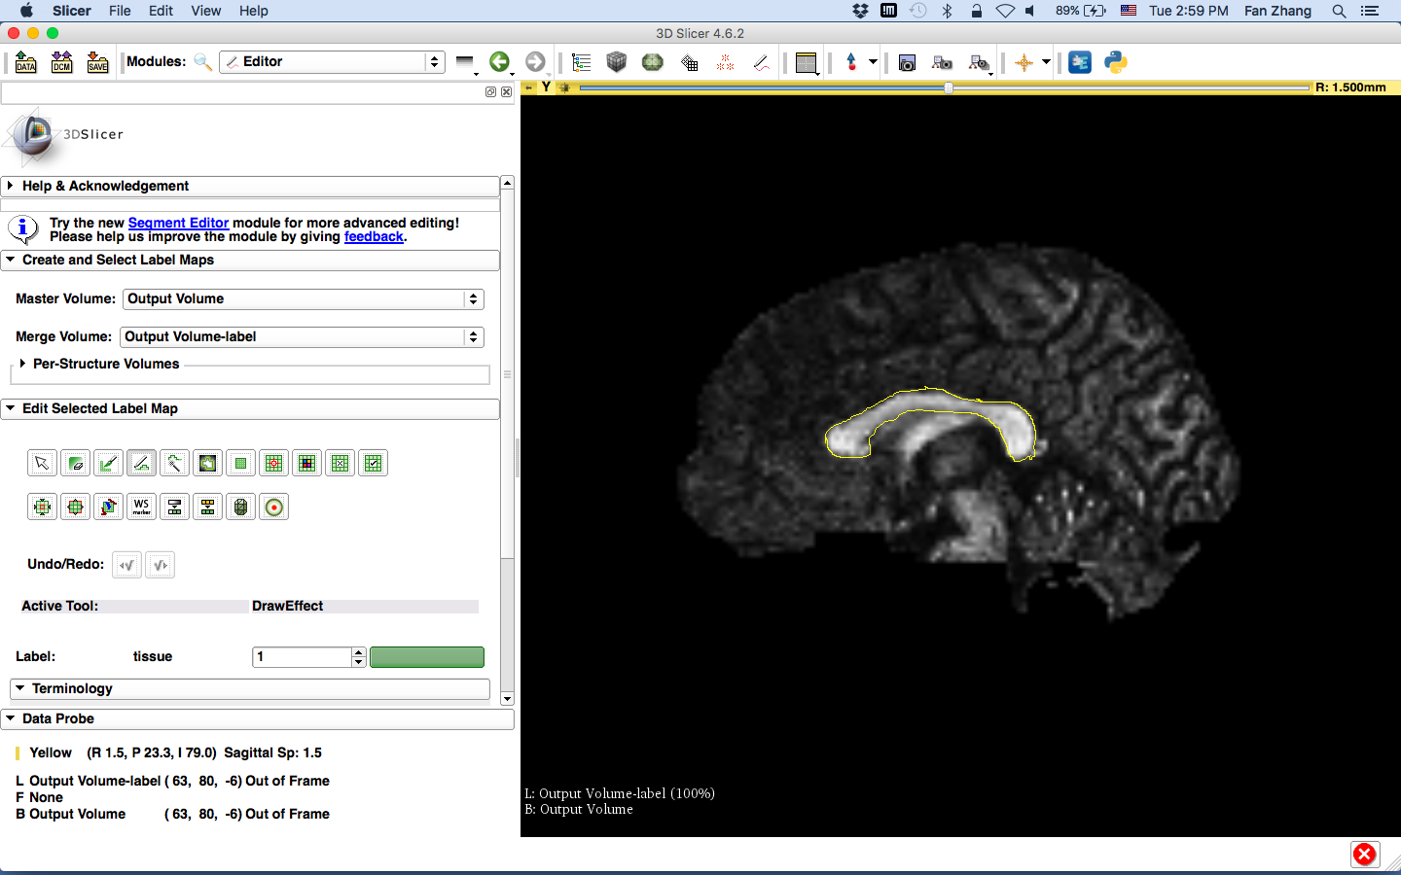
ROI Definiton
select the “DrawEffect” tool and mark the contour of CC

Slide 31
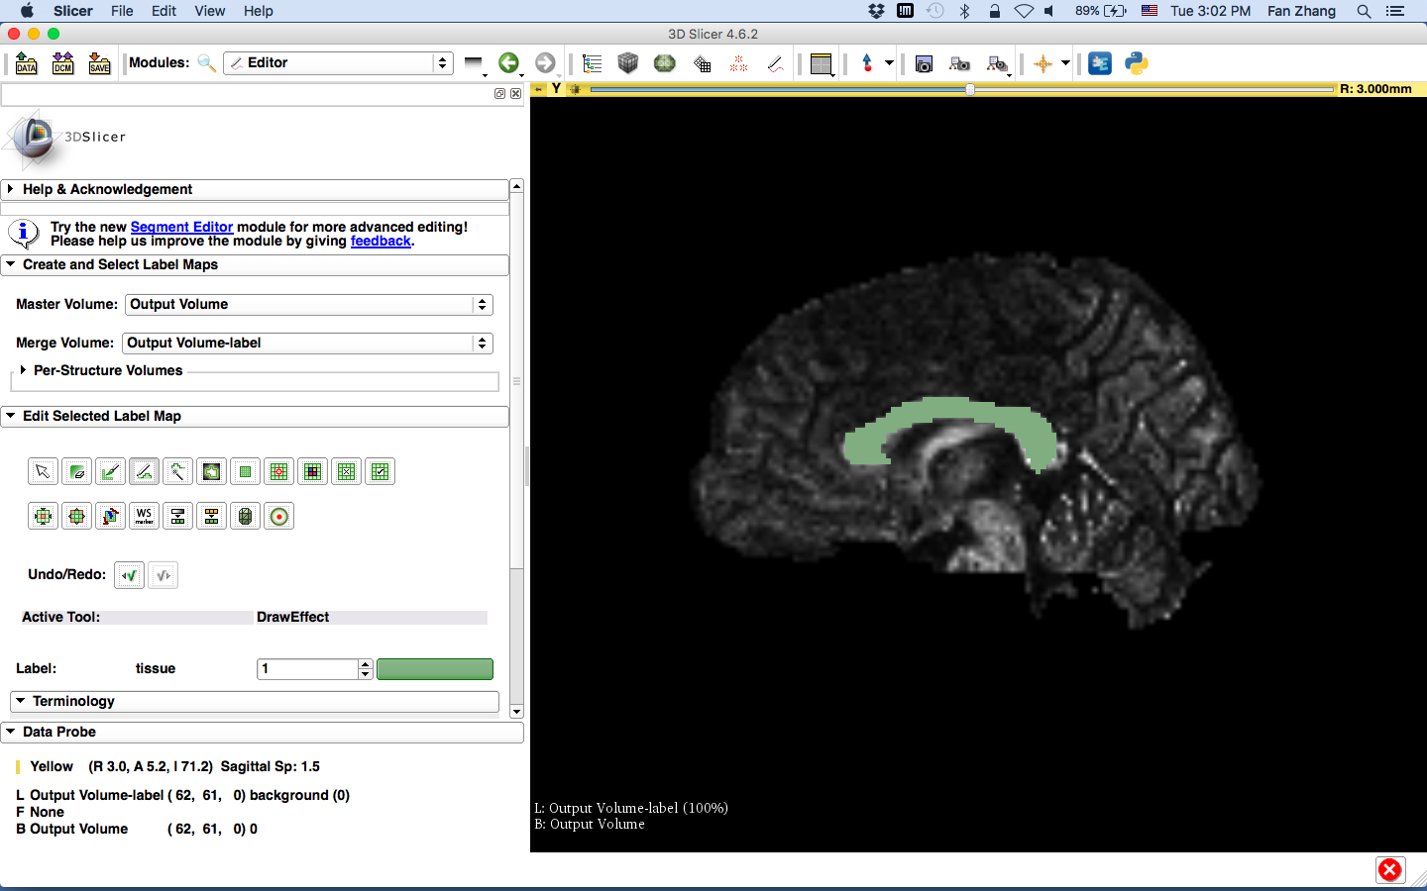
press enter
repeat this for 3 adjacent slices

Slide 32

label map containing the corpus callosum is created

Slide 33
UKF Tractography
The module can use different methods:
1-Tensor tractography (single fiber model)
2-Tensor tractography (crossing fiber model)
NODDI (estimates microstructural complexity of dendrites and axons)
The module can add a term for the free water model. This model tries to separate the signal from partial voluming with cerebrospinal fluid.

Slide 34
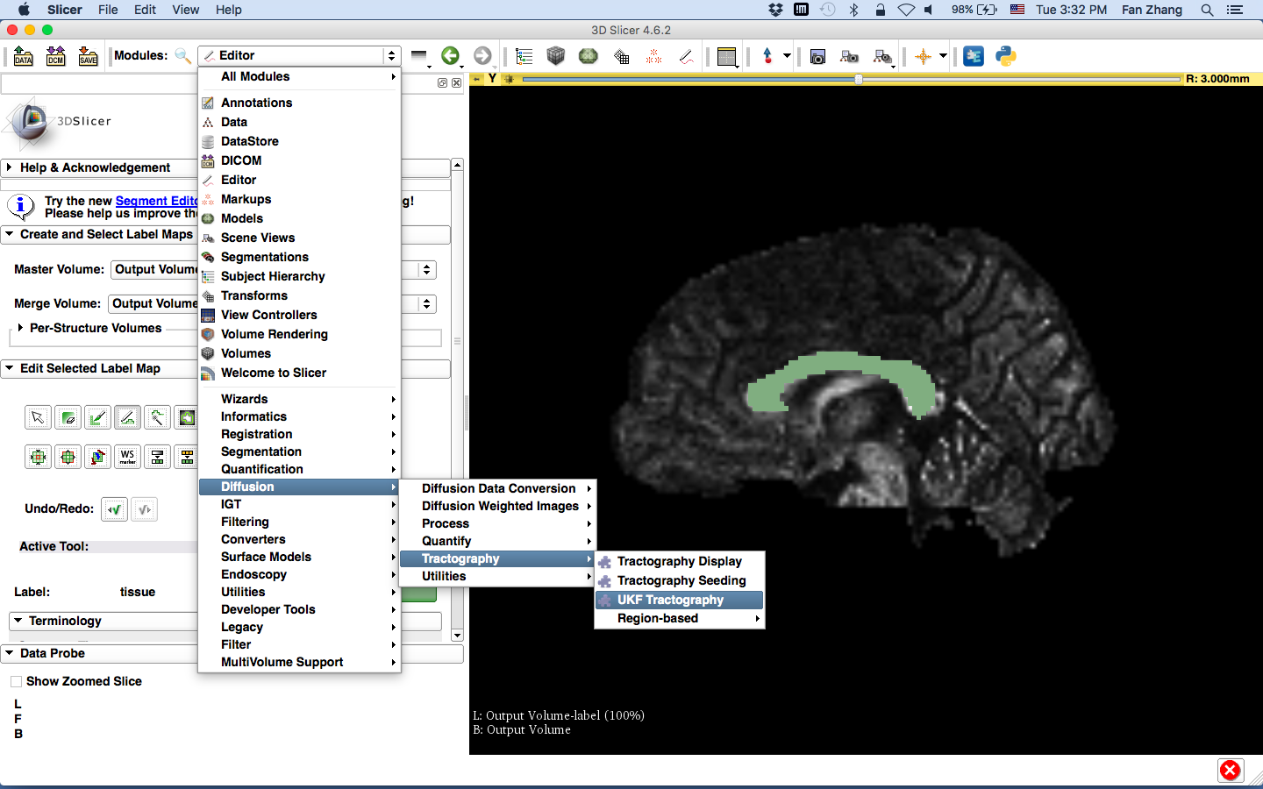
UKF Tractography Module

Slide 35
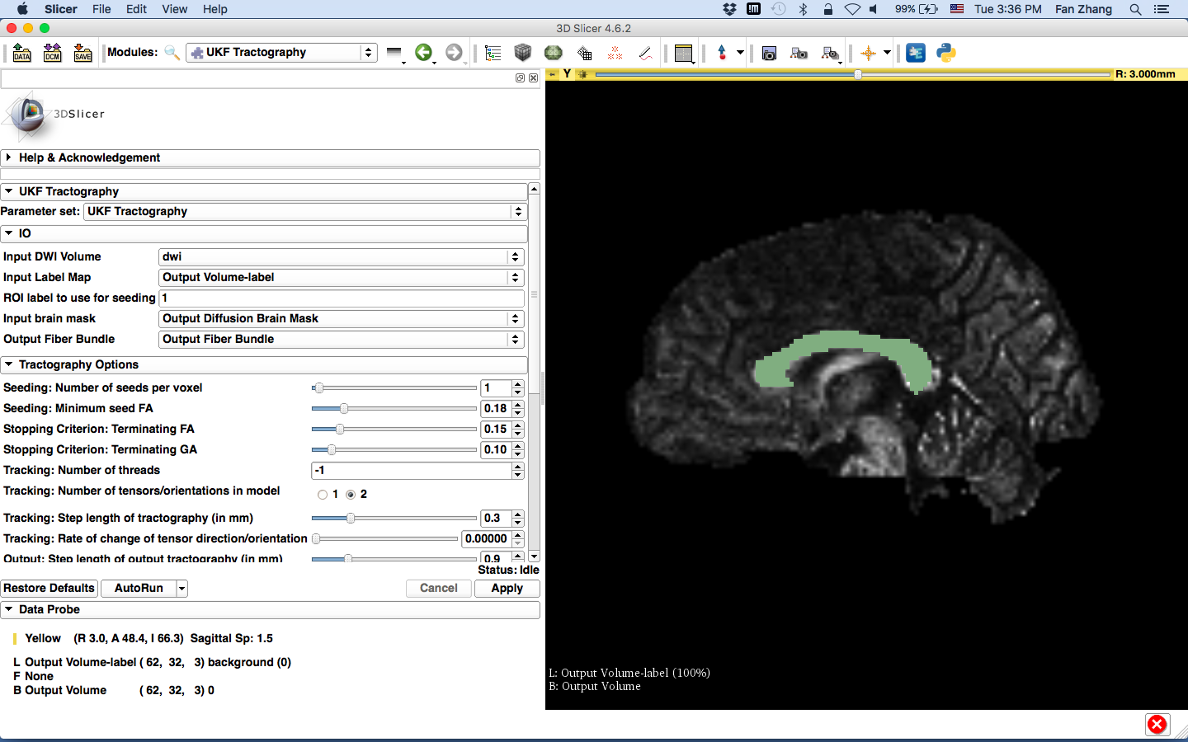
select the label map as seeds for tractography
select the number of the label map
select the Mask to confine the tractography
create new FiberBundle

Slide 36
for bigger voxels, use higher number of seeds per voxel
To increase seeding sensitivity, lower seed FA (0.15)
To track further, lower terminating FA (0.1) and GA (0.075)

Slide 37
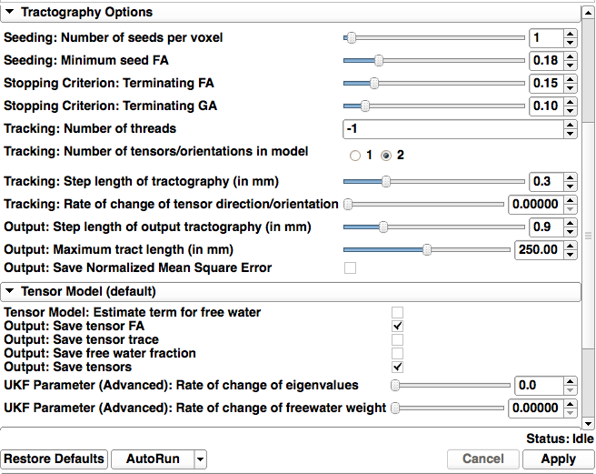
Set other parameters here:
find out more details at:
Documentation/Nightly/Modules/UKFTractography
Click Apply

Slide 38
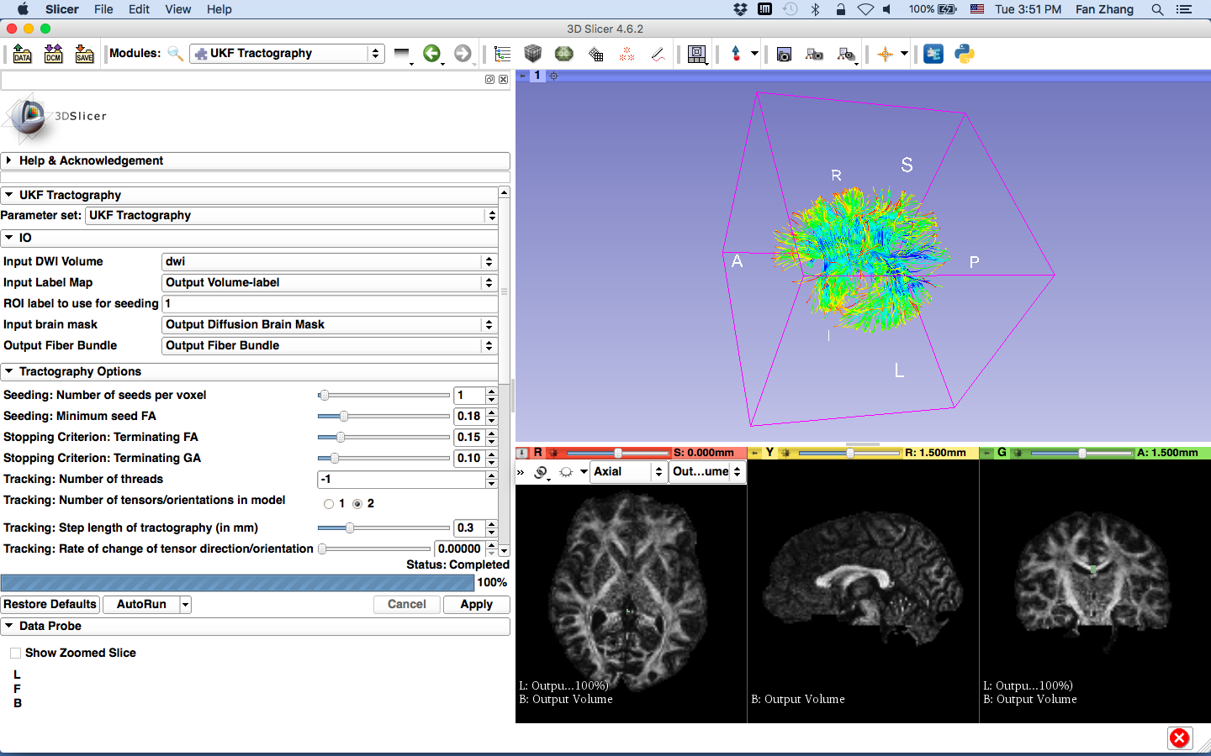
Corpus Callosum

Slide 39
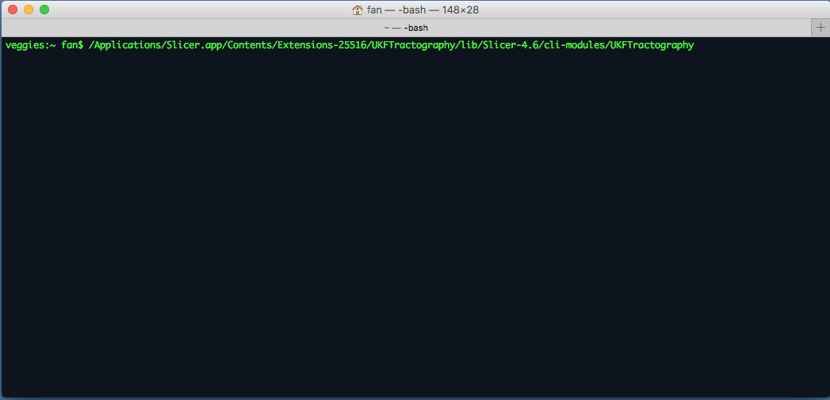
Run UKF Tractography in CLI
- Open a terminal (The tutorial is based on Mac system: Go to Application->Utilities-> Terminal.app)
- Locate the CLI module path of UKFTractography

Slide 40
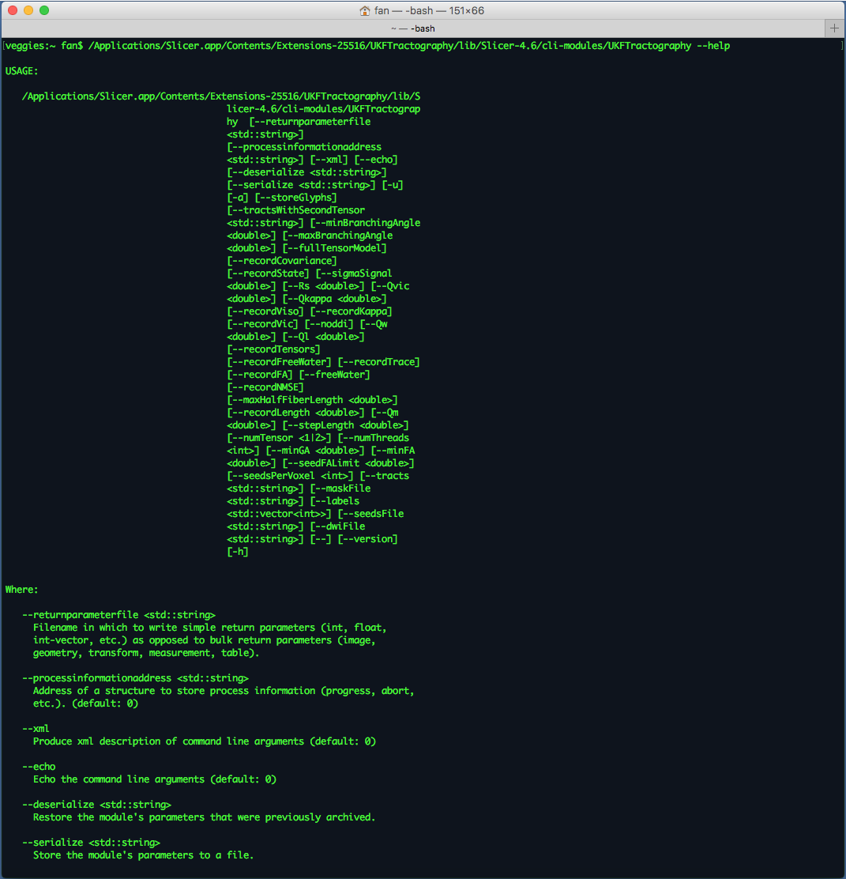
Run UKF Tractography in CLI
Run ‘/Applications/Slicer.app/Contents/Extensions-25516/UKFTractography/lib/Slicer-4.6/cli-modules/UKFTractography –help’ to find detailed documentation of the usage of UKFTractography

Slide 41
Conclusion
This tutorial, helps you to load diffusion data, run the tensor estimation, calculate scalar measurements, and define ROIs to finally be able to run UKF tractography.
contact: yogesh@bwh.harvard.edu

Slide 42





Acknowledgments
U01CA199459, Open Source Diffusion MRI Technology For Brain Cancer Research
National Alliance for Medical Image Computing (NA-MIC) namic.org
National Center for Image Guided Therapy (NCIGT) ncigt.org Neuroimage Analysis Center (NAC) nac.spl.harvard.edu
Surgical Planning laboratory (SPL) spl.harvard.edu
Psychiatry Neuroimaging Laboratory (PNL) pnl.bwh.harvard.edu

